Slide 1



TA CALCULATOR
For Easy Income Ta Calculations

Slide 2

Abstract
An income tax calculator is a web-based tool that estimates an individual or household's income tax. It asks for information like income, ﬁling status, and deductions to calculate tax liability. It helps users understand their tax obligations and compare tax strategies. Data storage and retrieval are done using Django with a MySQL database, ensuring user data security. The website offers a user-friendly interface for easy income tax calculation.

Slide 3

Project Requirements
Features of the Project
The features of this website are:
Tax Calculations
Report Generation
Analytics of Tax reports
Tax Savings Guide
Tax Slab Rates
Mobile Responsiveness
User-Friendly Interface.
Administrative Dashboard.

Slide 4


FEATURES A D HIGHLIGHTS
1.Users can register and login into the system. 2.Users can calculate Taxes.
3.Users can view different Tax Savings Guide. 4.Users can add Tax Details.
5.User can view their respective Tax details. 6.User can take print of Tax details.
The Admin can view
The whole Database 2.Tax Calculations 3.Dynamic Elements
Admin can add Tax Details. 9.Admin can add User Details. 10.Admin canedit all details.

Slide 5


TECH
ICAL ASPECTS
Presentation Layer:
User Interface (UI): This layer includes the components that interact with users, such as web pages or mobile app screens.
Django Templates: Django's built-in template engine allows you to deﬁne HTML templates that render dynamic content and interact with the back- end.
Jazzmin package: Jazzmin provides a very interactive Django admin panel GUI
Chartjs: Javascript library that provides interactive charts for analytics
Application Layer:
Django: Django serves as the back-end framework, handling HTTP requests, routing, and managing the application's business logic.
Django Views: Views receive requests from the user interface, process data, and generate appropriate responses. They interact with models, services, and external APIs as needed.

Slide 6

Challenges
User Experience and User Interface: Designing an intuitive and user-friendly interface for calculating income tax can be a challenge. Conduct user research, gather feedback, and iterate on the user interface to provide a smooth and hassle-free experience for users. Focus on usability, responsiveness, and accessibility considerations.
Coding the logic behind Tax calculations were
really difﬁcult. It was completed after days of coding and getting help from friends
Testing and Quality Assurance: Thoroughly testing the Tax calculations to identify and ﬁx bugs, as well as ensuring its reliability, can be a signiﬁcant challenge. Implementing unit tests, integration tests, and conducting usability testing can help ensure the system functions as expected and meets user requirements.

Slide 7

FUTURE E HA CEME TS
Mobile Application: Develop a mobile application for the Tax Calculation to allow users to easily Calculate Income Tax, receive notiﬁcations, and manage their income and have insights on their mobile devices.
Real-Time Availability: Implement real-time availability updates to provide users with up-to-date information on Tax Calculations.
Other Tax calculating Options: Other Tax calculating Options such as Sales tax, Deferred Tax Calculator, House Rent Allowance Calculator etc.
Different Version for each country : which provides extra features such as tax payment recommendations, analytics

Slide 8

References
https://incometaxindia.gov.in/Pages/default. aspx
https://groww.in/calculators/income-tax- calculator
GitHub Repo:
https://github.com/asimthaha/tax-calculator-django.git

Slide 9

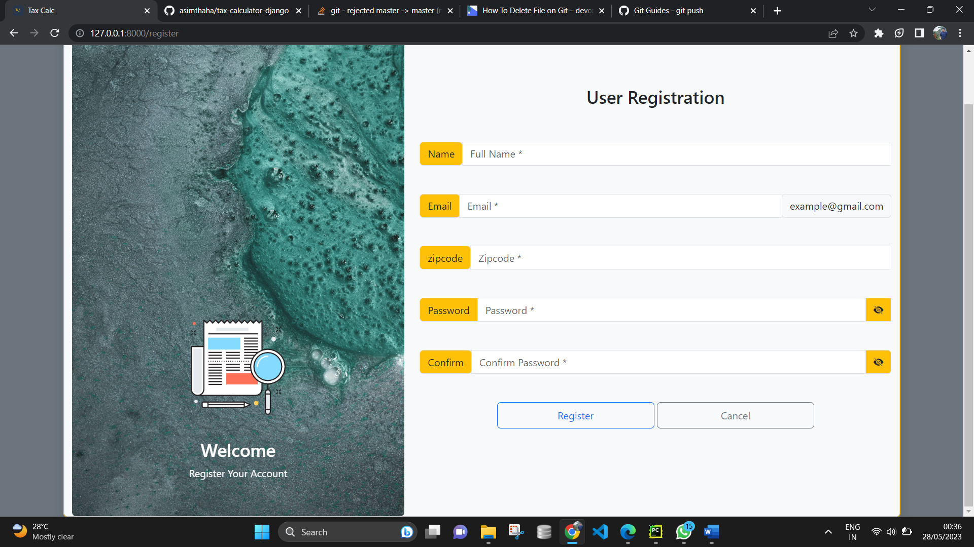
SCREENSHOTS

Slide 10
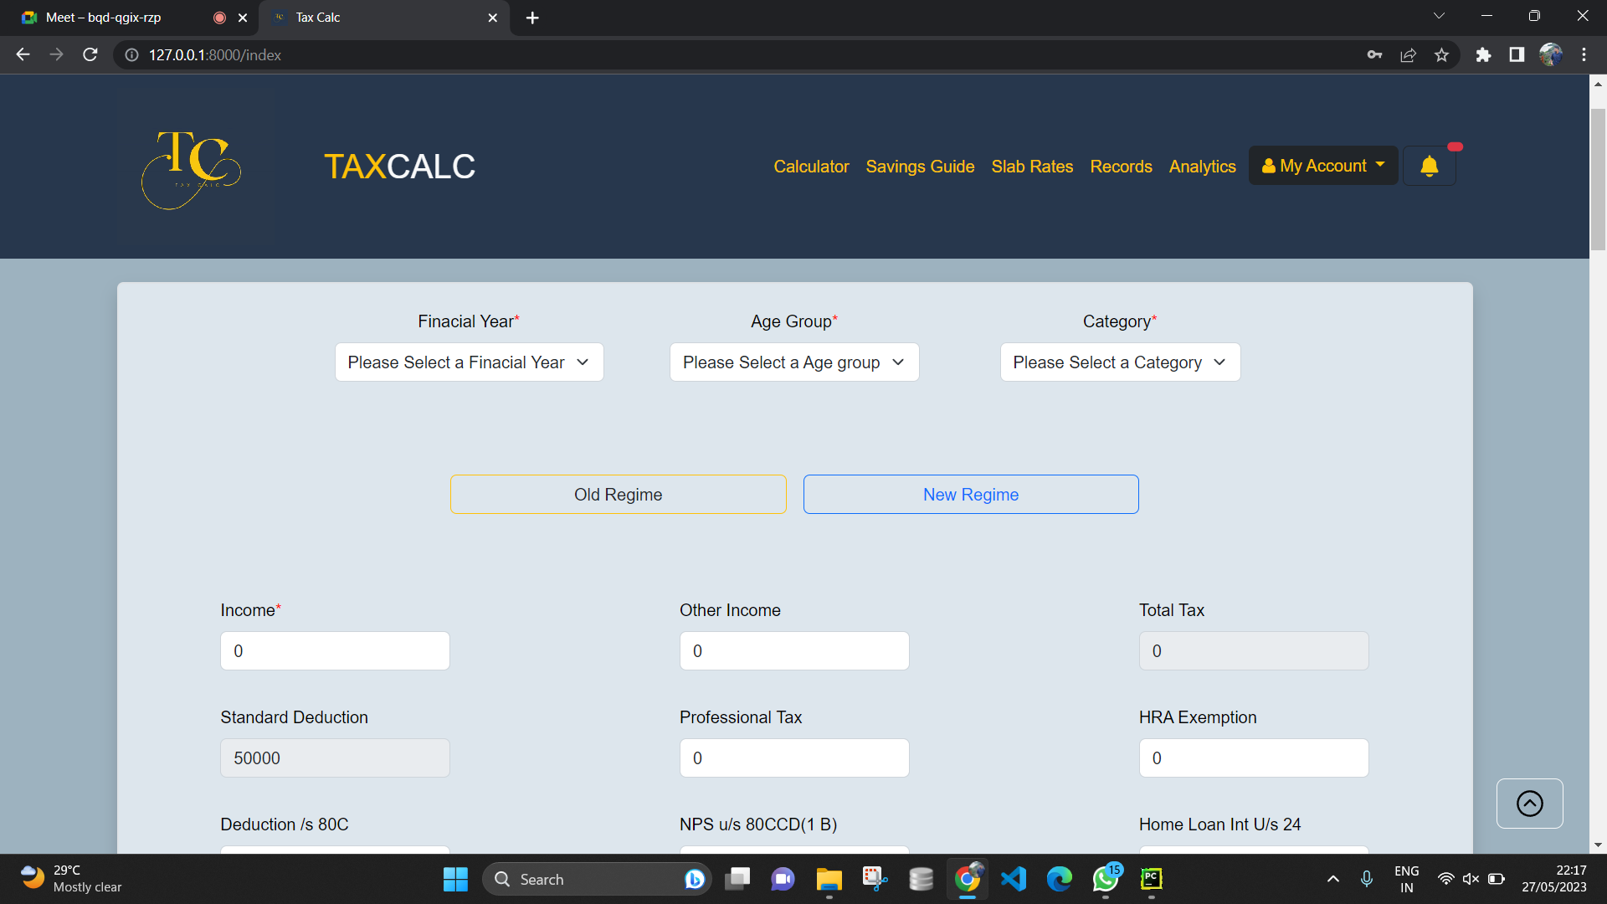

Slide 11
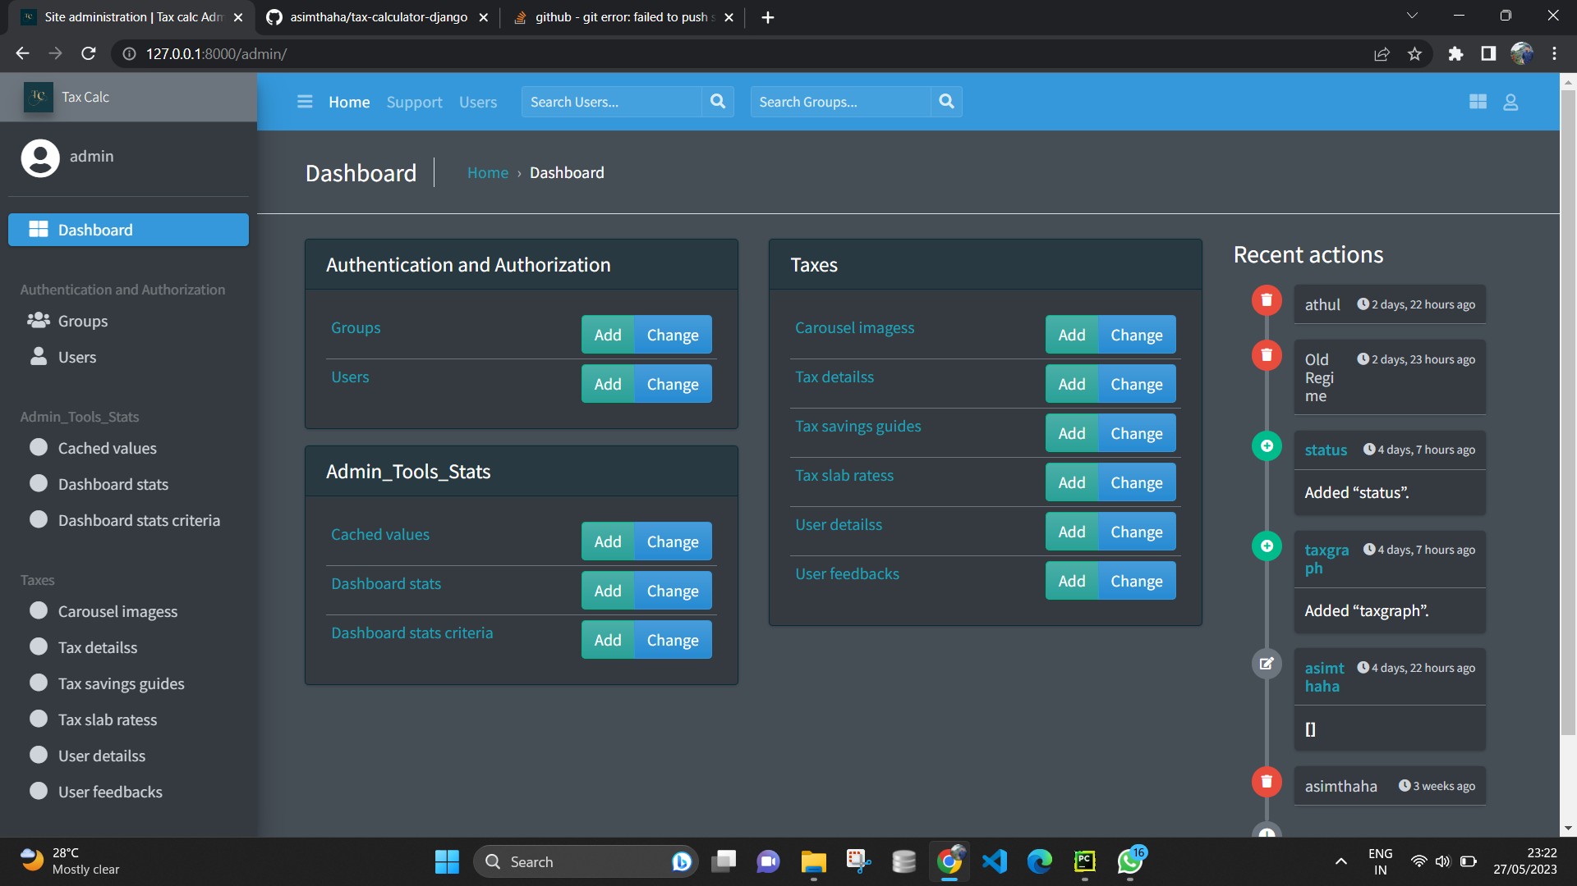

Slide 12
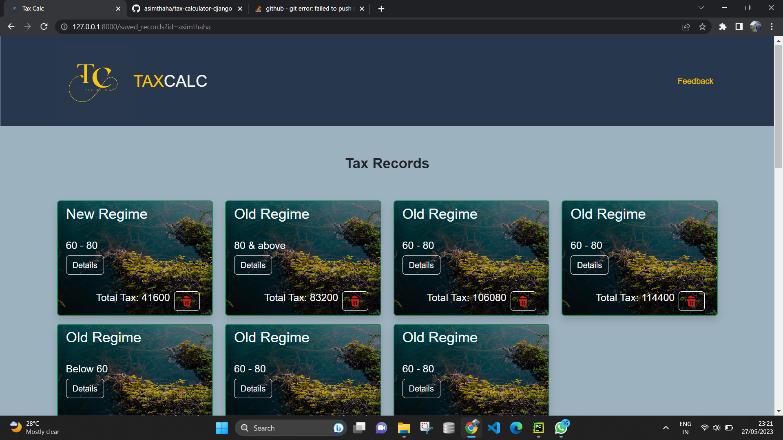

Slide 13
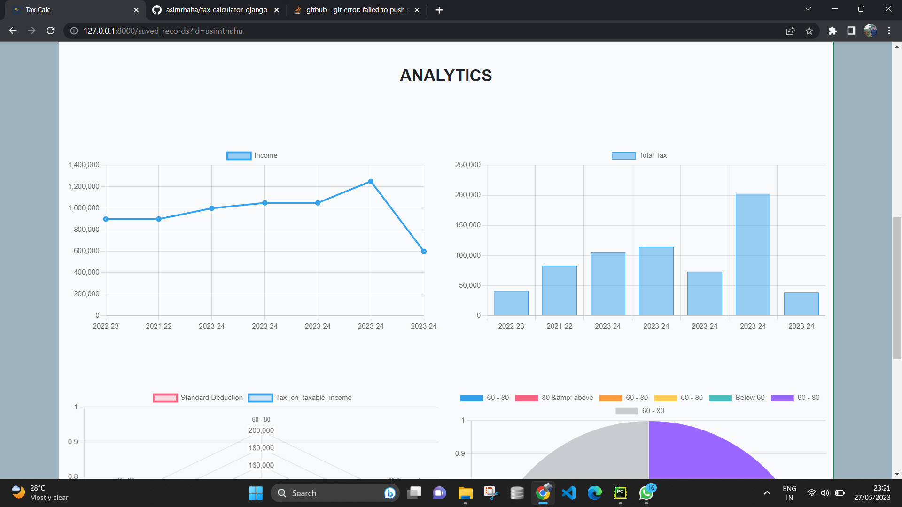

Slide 14


CO CLUSIO
The project was successfully within the time
completed
span allotted. All the
modules are tested separately and put together to form the main system. Finally, the modules are tested with real data and it worked successfully. Thus the system has fulﬁlled the entire objective deﬁned. Our goal of developing this Income Tax Calculation System has come to a good result without many defects.

Slide 15
Thanks!
Visit My Github: https://github.com/asimthaha

